Slide 1
Lecture No.32 Metallurgy
At the end of this lecture, students will be able to:
Explain the process of extraction of iron
Discuss the purification of iron
Describe the uses and properties of iron

Slide 2
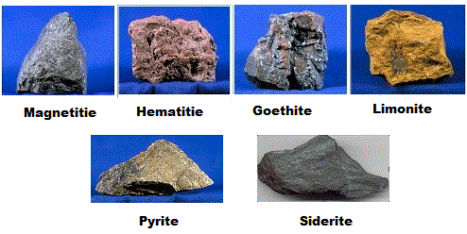
Metallurgy of Iron
Occurrence:
Next to ‘Al’ iron is the most abundant metal in earth’s crust
Iron is the 4th most abundant element
Iron has strong affinity to oxygen so it is not found in nature in the elemental state but only in combined state
Iron is often found as oxide
Important ores:
Haematite, Fe₂O₃
Limonite, Fe₂O₃.H₂O
Magnetite, Fe₃O₄
Iron pyrites, FeS₂
Siderite, FeCO₃

Slide 3
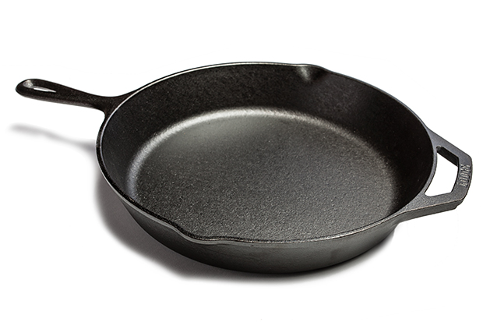
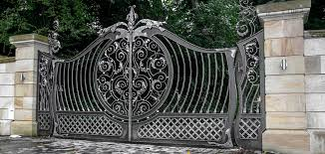
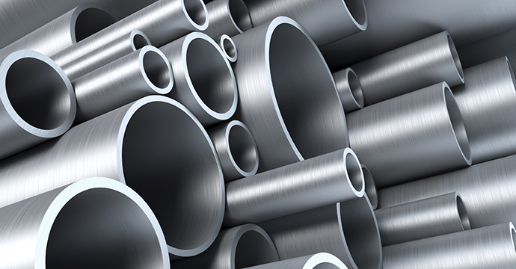
Commercial forms of Iron
(i) Cast or Pig iron – It is the most impure form of iron. It contains about 2.5 % to 4.5 % carbon. Other impurities like Si, P, Mn and S are present up to about 1.5 %
(ii) Wrought or Malleable iron – It is the purest form of iron. It contains
about 0.2 % carbon
(iii) Steel – It is an alloy of iron with carbon and other elements like manganese, silicon and phosphorus.
It is midway between cast and wrought iron as far as impurities are concerned.
It contains 0.1 to 1.5 % carbon

Slide 4
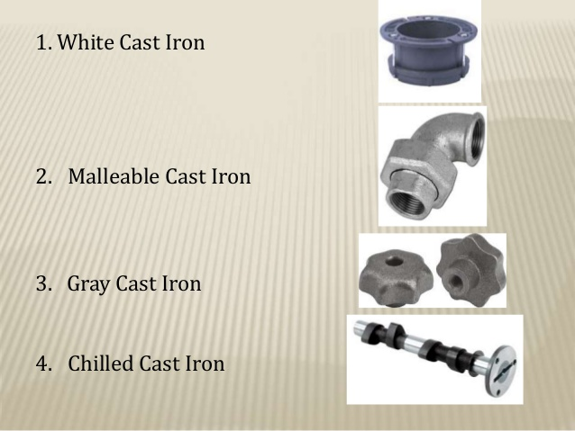
Cast Iron
Cast iron is available in two forms,
(i) White cast iron:
Contains carbon as iron carbide, Fe₃C and small amount of graphite
Obtained by cooling the molten pig iron quickly
(ii) Grey cast iron:
Contains carbon as graphite and small amount of Fe₃C
Obtained by cooling molten pig iron slowly

Slide 5
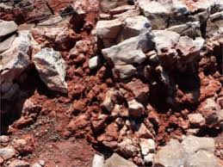
Cast Iron from Haematite
Concentration of ore:
Ore is crushed into small pieces of 3 to 5 cm size
Ore is washed with water to remove silicious impurities
Roasting the ore:
Ore is roasted with some amount of coal where following reactions take place
$2Fe_{2}O_{3}.3H_{2}O →2Fe_{2}O_{3}+3H_{2}O↑$
$FeCO_{3} →FeO+CO_{2} ↑$
$4FeO+ O_{2} →2Fe_{2}O_{3}$
Water and CO₂ are removed along with other impurities such as sulphur, arsenic, phosphorous
During smelting FeO will form slag as FeSiO₃ but Fe₂O₃ will not

Slide 6
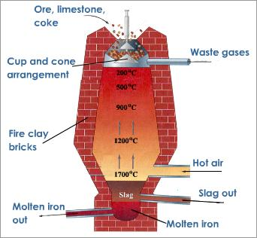
Cast Iron from Haematite
Smelting:
Ore is mixed with flux (limestone) and coke in 8:1:4 ratio
In a blast furnace the mixture is heated
Charged from the top and hot air is sent from the bottom
After the reactions, waste gases are escaping from the top and molten metal along with slag are collected at the bottom

Slide 7
Cast Iron from Haematite
From top to bottom temperature increases in the furnace
Moisture is removed in the first stage
At 400ºC -700ºC, oxygen reacts with coke and forms CO which further reduces the ore into spongy iron
$$2C+ O_{2} →2CO ↑$$
$$Fe_{2}O_{3 }+3CO →2Fe(spongy iron)+3CO_{2} ↑$$
CaCO₃ is decomposed at high temperatures and form CaO which forms slag (CaSiO₃) with SiO₂ impurities
Slag floats over the molten iron layer and protects iron from oxidation
Molten iron is removed from the bottom and allowed to solidify which is called pig iron
Pig iron can be melted and cast in moulds which is called as cast iron

Slide 8
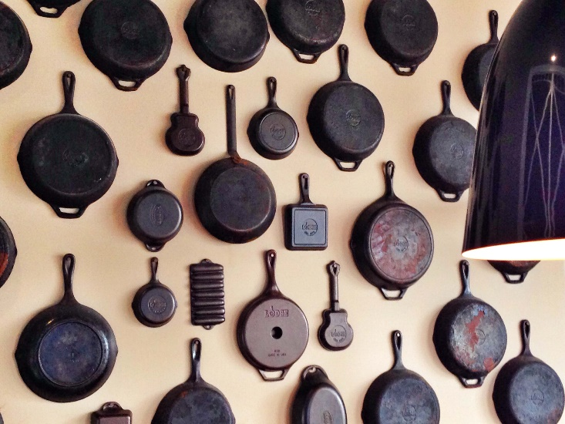
Properties of Cast Iron
It is the most impure form of iron
Contains high amount of carbon
Melting point of cast iron = 1250ºC; Melting point of pure iron = 1530ºC
Cast iron has higher strength and hardness
But brittle in tension
It does not rust easily

Slide 9
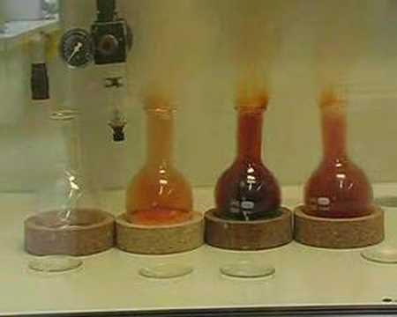
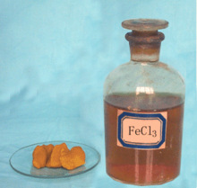
Properties of Cast Iron
When heated in air, it is oxidized and gets covered with thick bluish black scales of ferric oxide Fe₃O₄
When steam is passed over iron heated to 800⁰C to 1000⁰C, iron is oxidized to Fe₃O₄
Acids form salts of iron
Fe + 2 H₂SO₄ → FeSO₄ + SO₂ + 2H₂O
When heated with sulphur it forms ferrous sulphide and with dry chlorine it forms ferric chloride
Fe + S → FeS
2Fe + 3Cl₂ → 2FeCl₃

Slide 10
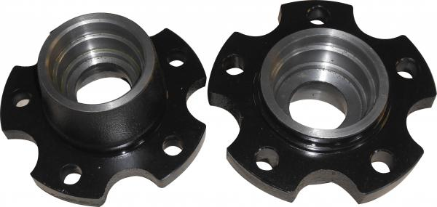
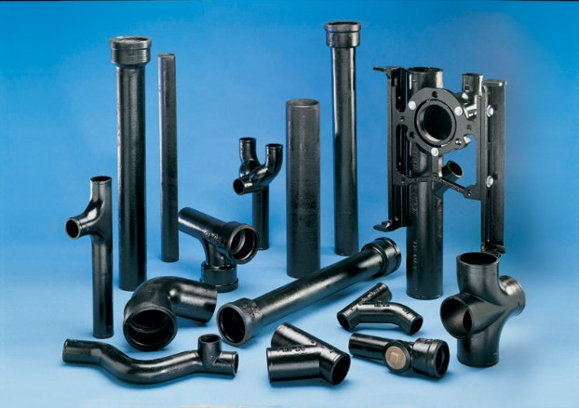
Uses of Cast Iron
Car parts – cylinder heads, blocks and gearbox cases
Foundation for big machines (good damping property)
Pipes, lids (manhole lids)
Bridges, buildings
Cook wares – Excellent heat retention
Used to manufacture wrought iron and steel

Slide 11
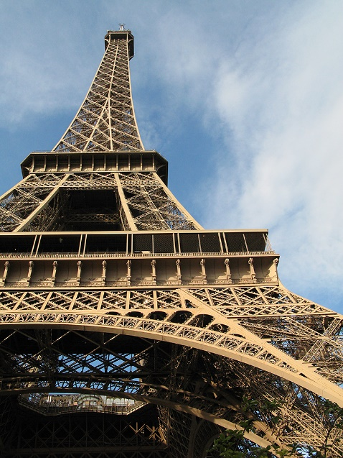
Wrought Iron
Purest form of iron with 0.12 to 0.25 % carbon and impurities like S, P, Mn etc. up to 0.3 %
It melts at a higher temperature ( 1500⁰C) than cast iron
It is obtained by purifying cast iron by the process known as puddling (i.e. stirring)
Contains some amount of slag inclusions
Before steel production this was used extensively

Slide 12
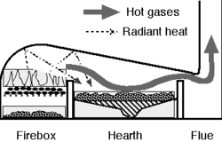
Wrought Iron from Cast Iron
Wrought iron is produced from cast iron by the process called puddling
Cast iron is heated in a special type of reverberatory furnace
Hot gases and flames are deflected by a low roof which can melt the cast iron and the molten iron is stirred or puddled by iron rods
Waste gases can escape through the chimney
Cast iron
Haematite lining

Slide 13
Wrought Iron from Cast Iron
Furnace hearth is lined with haematite (Fe₂O₃) which provides oxygen to oxidize the impurities like C, S, Si, P, Mn etc.
C, S, Si forms oxides where as other impurities like Mn, P forms slags
$$3C+Fe_{2}O_{3} →2Fe+3CO ↑$$
$$3S+2Fe_{2}O_{3} →4Fe+3SO_{2} ↑$$
$$2Mn+O_{2} →2MnO$$
$$2MnO+SiO_{2} →MnSiO_{3} (slag)$$
Thus impurities are removed and pure wrought iron is obtained

Slide 14
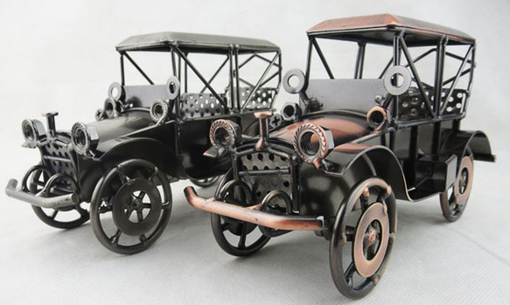
Properties of Wrought Iron
It is grey in color
It is soft, ductile and malleable
It is extremely tough and resistance against corrosion is high
Cab easily be welded and worked under hammer
Suitable for rolling and forging

Slide 15
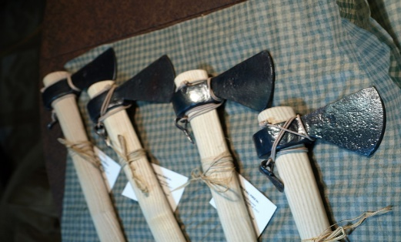
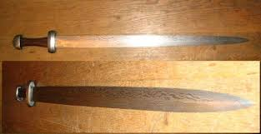
Uses of Wrought Iron
It is used to prepare chains, wires, bolts etc.
Railway couplings and carriages were made of wrought iron
It is used to manufacture articles which can withstand stress
Before the development of steel making wrought iron was the most commonly used malleable iron
In the past, wrought iron was refined into steel and used to make iron tools and weapons

Slide 16
Summary
Iron is the 4th most abundant element
Haematite is the important ore of iron from which it is extracted
Cast iron or pig iron, wrought iron and steel are the commercial forms of iron
Haematite ore is heated at high temperatures in blast furnace and iron is melted
Impurities are separated as slag CaSiO₃
Wrought iron is produced from cast iron by the process called puddling
It is the Purest form of iron with 0.12 to 0.25 % carbon
Cast iron is heated in a special type of reverberatory furnace and iron is melted where as impurities are oxidized and removed

